Slide 1
The Prison Break Connection
A Co-op Stealth Game
By Anuj Patwari
K1840581

Slide 2
Overview
Genre – Stealth, First Person, Co-op
Target Audience – 15+ Years
Platform – PC, PS4, XBOX One, PS3, XBOX 360, Switch

Slide 3
Character Descriptions
Lewis Huber
Mist
Small Spaces
Cunning mind
Daisy Huber
Lewis’ wife
Read Lewis’ mind
Make marks on Lewis’ body
Paranoid and easily scared
Carlos Mendez
Very rich businessman
Illegal activities
Frames innocent people

Slide 4
Introduction Story
Carlos Mendez Trafficking Children
Frames Lewis and Daisy
Lewis and Daisy go to talk to Mendez
Arrested and taken to Prison Special Interrogation Rooms
Insist they are being framed Cops leave room

Slide 5
Story Sequence - Brief
Steal police uniforms
Separate blocks of Prison
Find each other
Daisy finds weapon – Portable Hand Drill
Lewis finds map – Control Room
Escape Prison
Lay low
Find evidence of innocence and against Carlos Mendez
Submit evidence to prove innocence

Slide 6
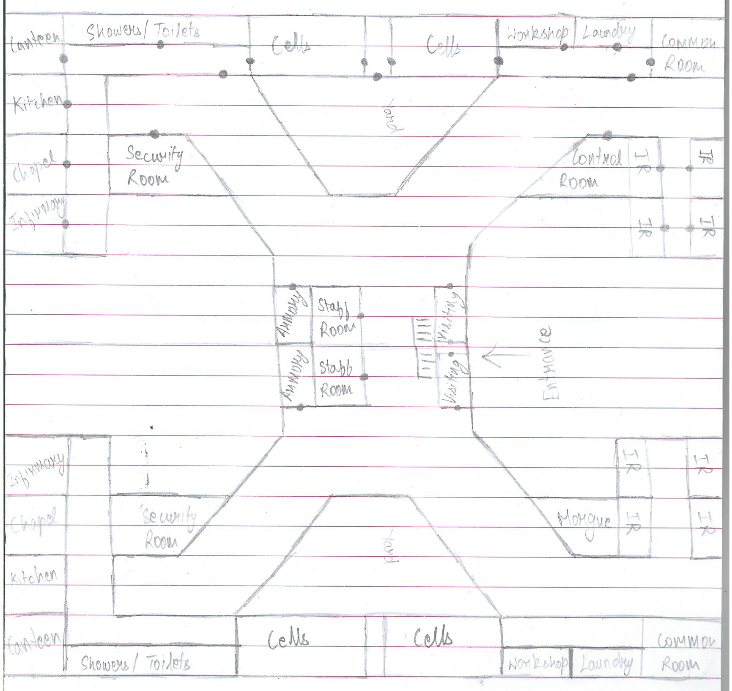
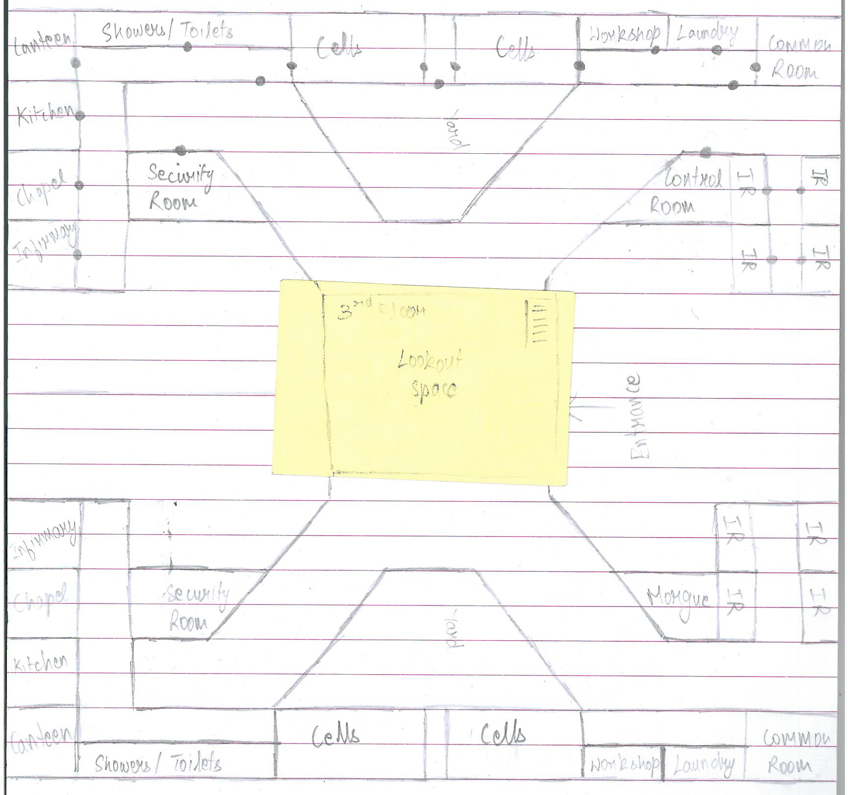
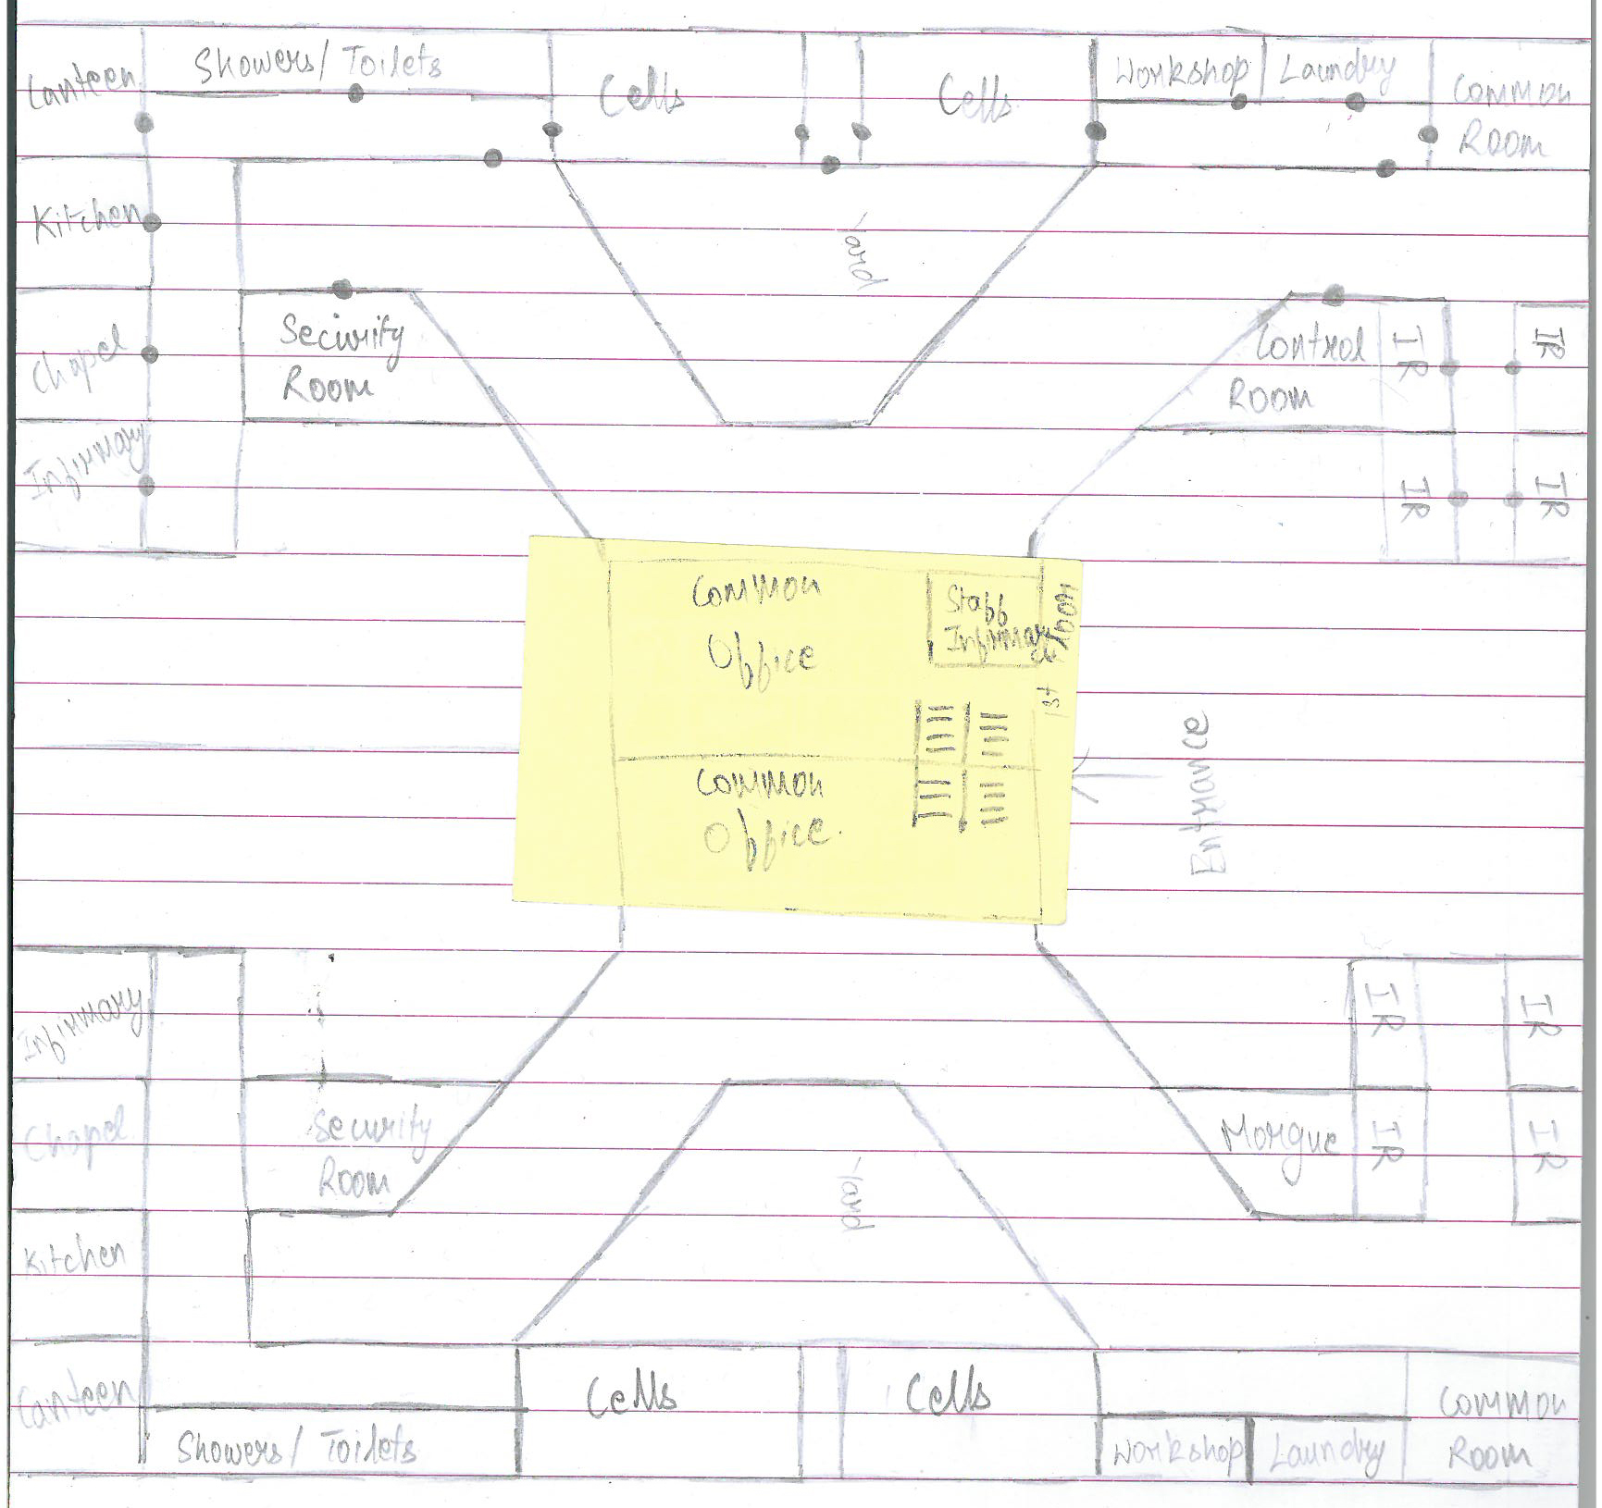
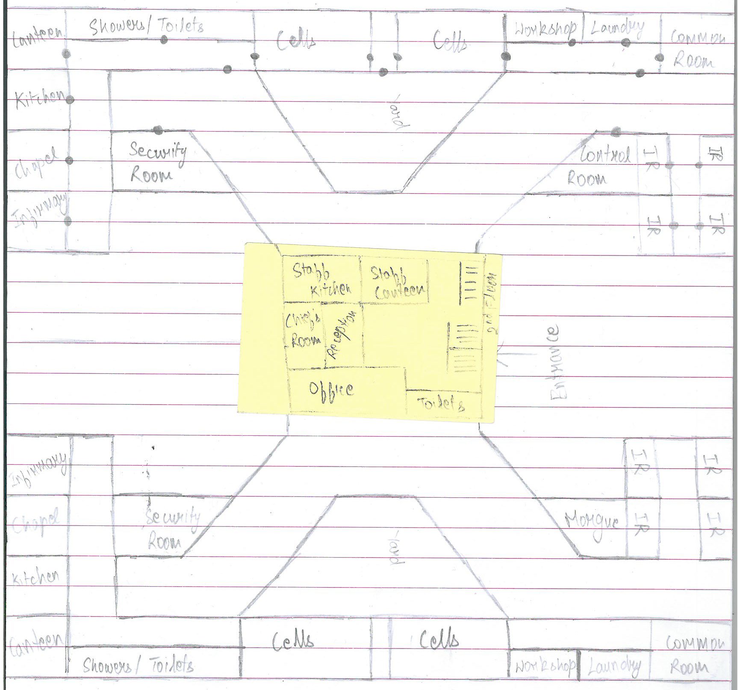
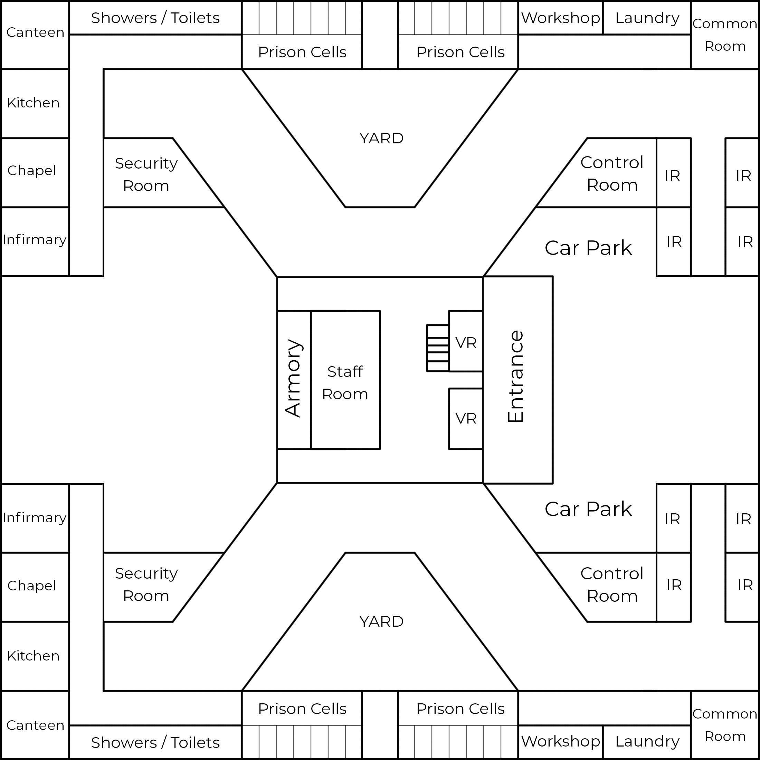
Level Design - Prison
Lewis
Daisy

Slide 7
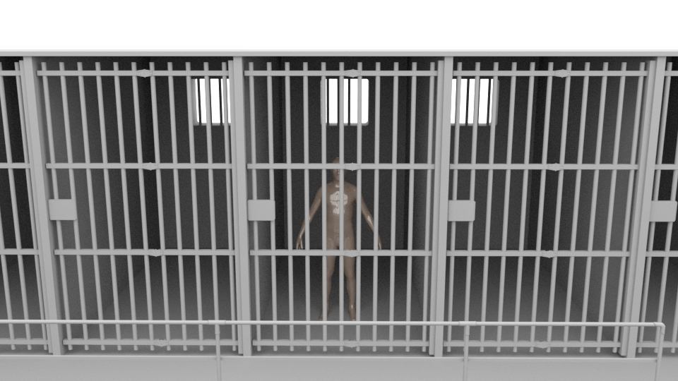
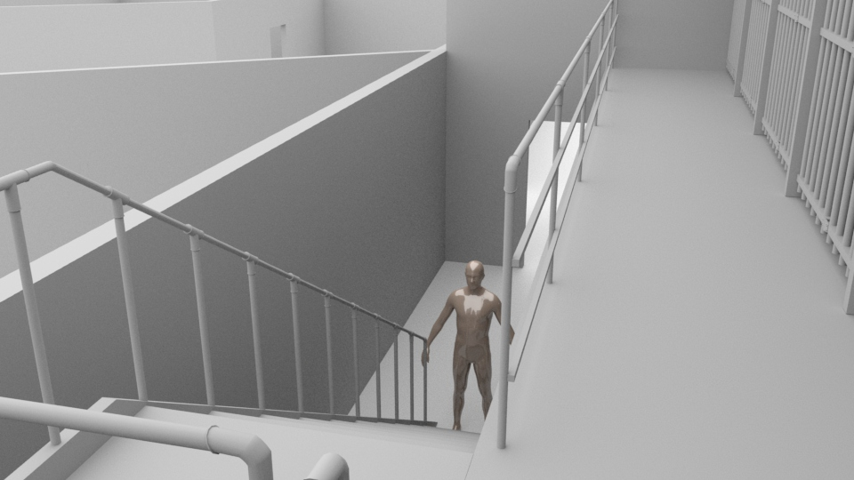
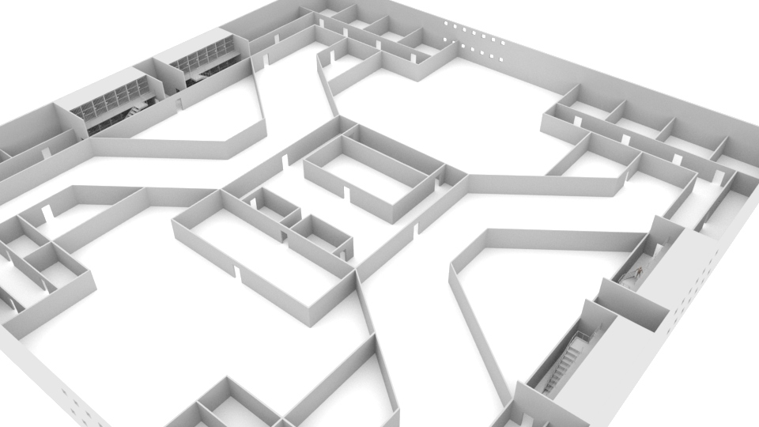
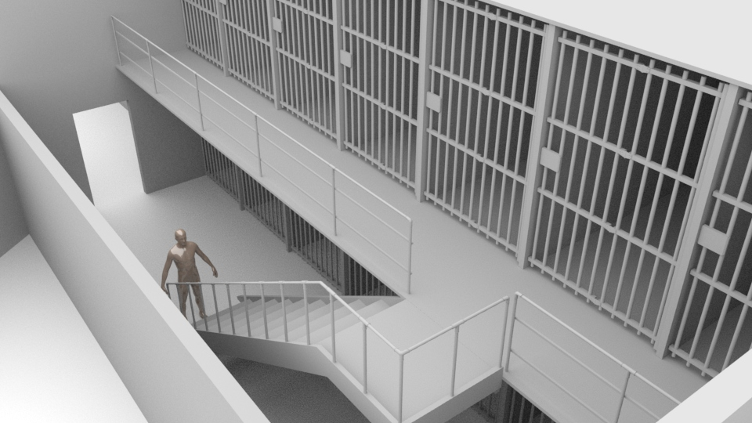
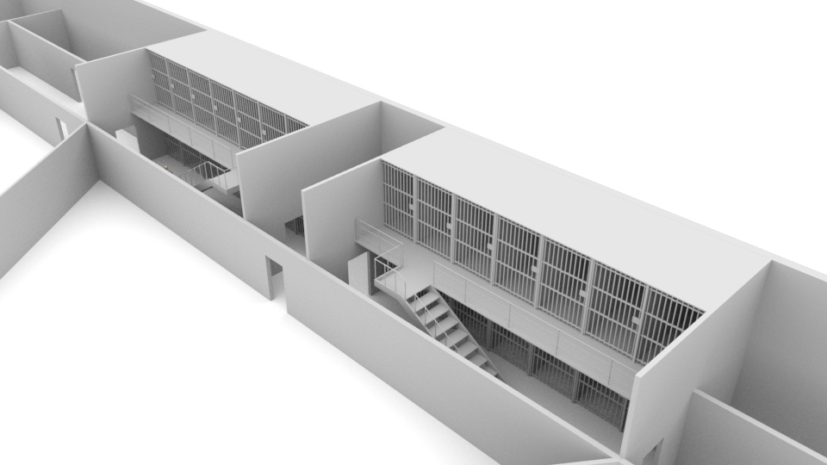
Level Design – 3D
Canteen
Kitchen
Chapel
Infirmary
Showers/Toilets
Prison Cells
Workshop & Laundry
Yard
Security Room
Interrogation
Rooms
Entrance
Control Room
Car Park

Slide 8
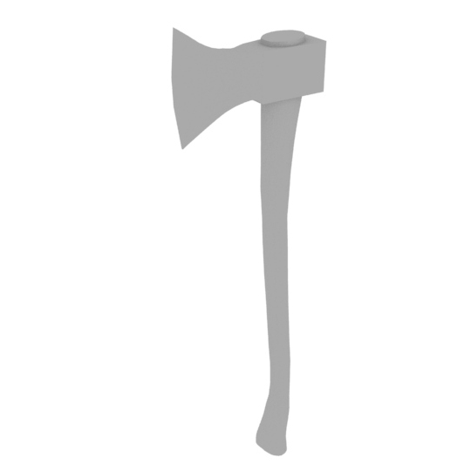
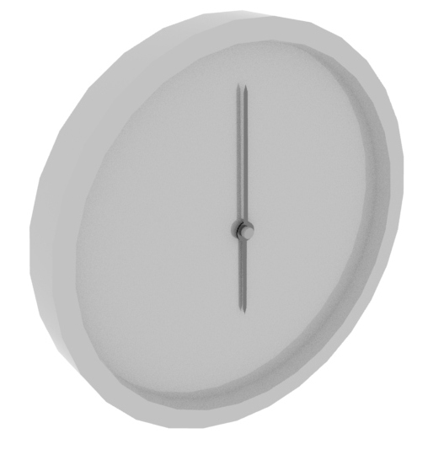
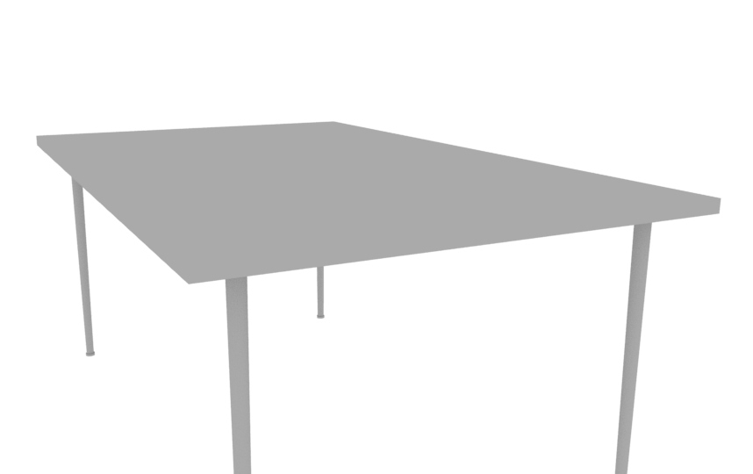
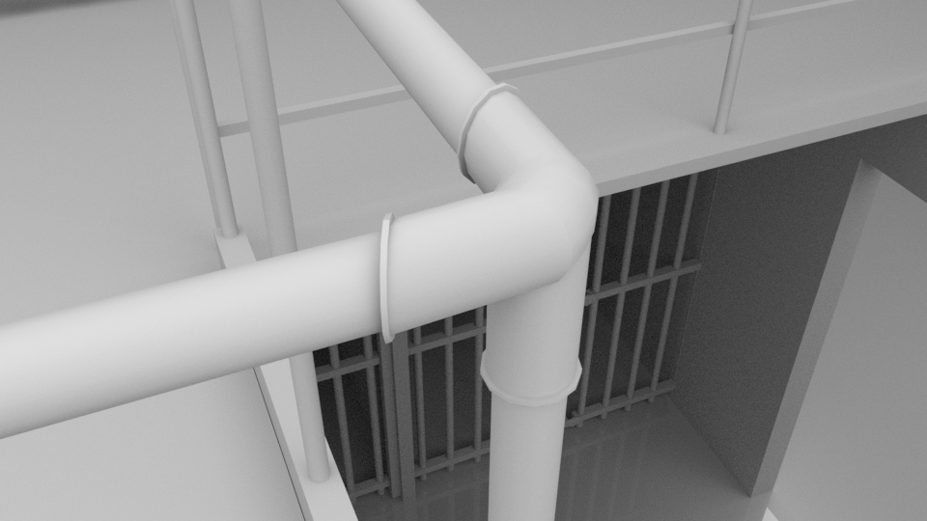
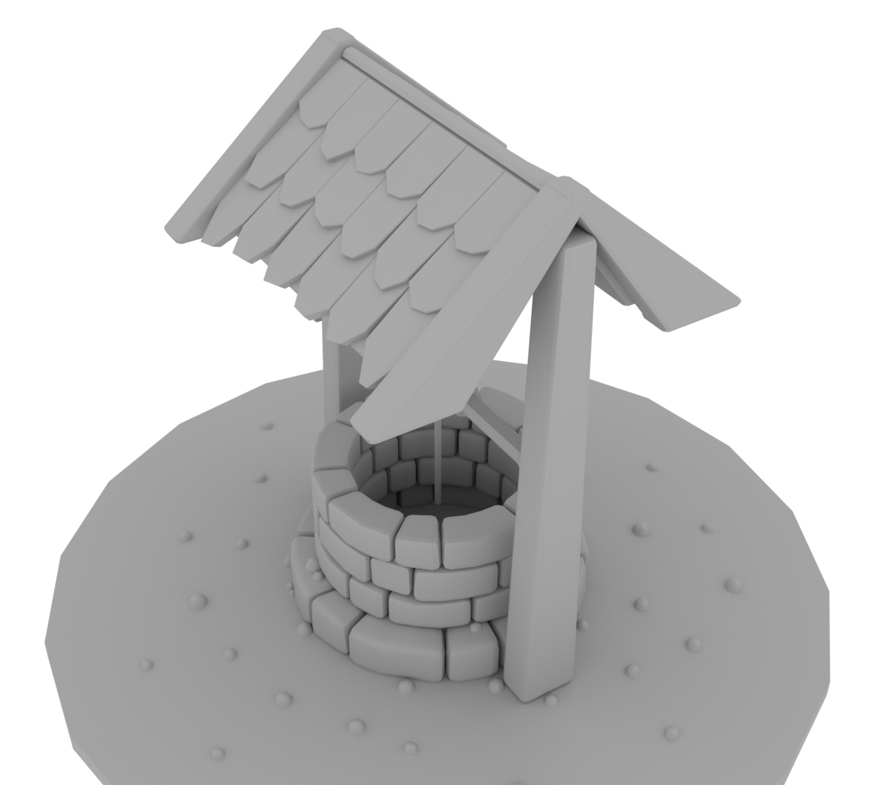
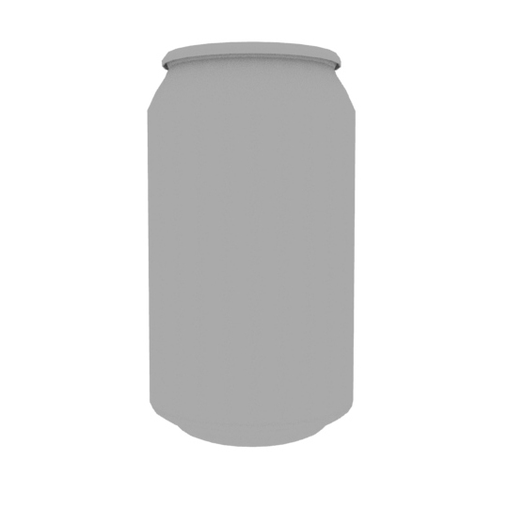
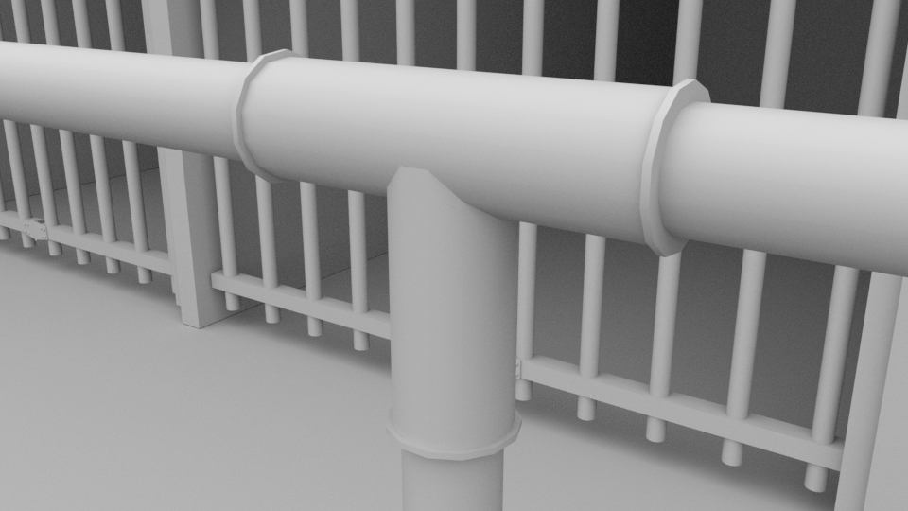
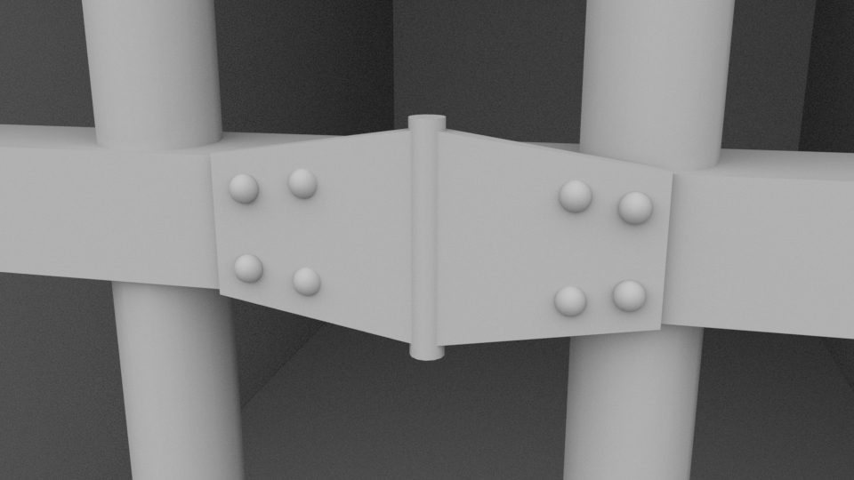

Models

Slide 9
What’s left?
Finalizing some sections of the GDD
3D Level Design - Population
3D Models

Slide 10
Deliverables
Game Design Document
Paper Designs
2D Level Design
3D Level Design
3D Models
Well, Gear, Clock, Axe, Can, Table, Plant, etc.
Report

Slide 11
Thank you

